Slide 1

Salesforce Implementation

Slide 2
Overview
Grainger PLC is the UK's largest listed residential landlord and leader in the fast-growing build-to-rent sector providing ±9700 rental homes to over 20,000 customers. Grainger PLC is planning
Grainger PLC has
EIMS Africa is led by a team of energy sector experts and is focused on maximizing shareholder returns, minimizing their risk of investment and doing so in a way that delivers lasting and sustainable social impact to the local communities that surround these projects.
Currently EIMS has been operating on the Old Mutual IT infrastructure and wants to move to their own IT environment. This will allow them to:
Create a modern and optimised business
Digitise and automate their manual processes
Align business stakeholders over correct information
Increase overall efficiencies, saving time and money
Optimise data capturing and provide more visual and trusted reporting
EIMS wants to derive value quickly through fit-for-purpose solutions and has asked Open Box to help deliver automated reporting and program management of the IT solution.

Slide 3
Problem Statement and Challenges
EIMS is currently a very manual business, operating off manual processes and systems.
A manual heavy environment lends itself to high inefficiencies, misalignment between stakeholders and increased errors in reporting and governance.
EIMS have many stakeholders requiring various reporting and insights into their business and operations. Creating the reports and consolidating all the data is onerous and taxing on the employees, taking them away from progressing other necessary objectives.
Challenges include:
Manual processes and reporting
Data errors
and duplication
Reliance on Old Mutual infrastructure and inability to be nimble
Misalignment between stakeholders
Inefficiencies & increased complexity
CHALLENGES

Slide 4
Goals and Objectives
Objective :
Implement a modern IT environment that automates appropriate processes and reports, delivering improved efficiencies and business insights.
Key Results :
Cloud based infrastructure and IT helpdesk
Data warehouse
developed
Real time, visual and consolidated reporting dashboards
Leverage data and business insights
Fit-for-purpose systems implemented for business functions

Slide 6
Roadmap
Share Point Migration
IT costs to board
Libryo
4 x Function Systems
4 x Function Systems
IT infrastructure
Migration of GP
As is Business process mapping and requirement gathering
To be Business process mapping
Roadmap
Data Environment set up
Reporting delivery
Reporting delivery
Reporting delivery
Discovery
M1
M2
M3
M4
M5
M6
M7
M8
M9
M10
M11
M12
M1
M2
M3
M4
2023
2023
2023
2024

Slide 7
RACI

Slide 8
Questions

Slide 9
Challenges
Renewals Very labour intensive, 3 people in team, 400 renewals in March, 1500 renewals in September

Slide 10
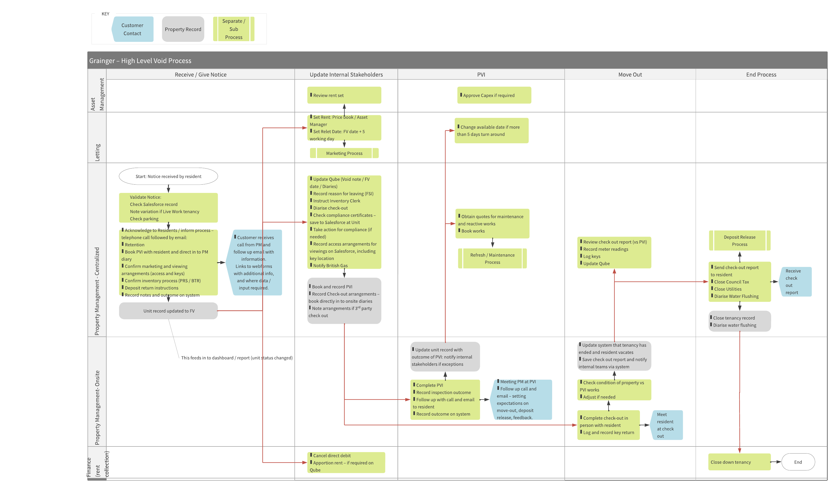

Slide 11
Qube demo:
  Understand the void-related information in Qube & what needs to remain vs what should be moved to a SF void process.
  Understand how Qube defines leases with a future SF Tenancy object in mind.
  Understand existing integration capabilities.
FSI demo:
  Understand the void-related information in FSI & what needs to remain vs what could be moved to SF void process.
  Understand existing integration capabilities.
Documents:
  Review where void-related documents should be saved &, if not in SF, understand existing integration capabilities.
SF:
  Deeper dive into the aspects of current functionality (unit data) that overlaps with void process & possible changes required.
Review detailed process.
  Confirm process variations required (milestones & dependencies for each): Standard refresh, unit sale, tenant is retained, refurbishment.
  Unpack milestone tasks & documents required.
  Understand move out acknowledgement email/webforms requirements & tenant inputs (DRI).
  Discuss milestone / task ownership requirements
Review reporting / dashboard requirements, access levels, KPI/benchmarks
If I was left to my own devices (with unlimited time) I would suggest the following deliverables -
Future-state process diagrams:
  Proposed release 1.0 process (including process variations)
  Proposed process incorporating future enhancements.
Project proposal document:
  Proposed solution
    Scope/objectives of release 1
    Scope/objectives & priority of subsequent enhancements
  Sample screen & sample dashboard mockup
  Solution context and/or high-level architecture diagram for release 1
    Identify which capabilities are out the box SF, custom SF, or external.
    Identify integration points.
    Identify user groups & high-level access/touch points.
    Integration approach
    Document / file management approach
    Reporting approach
  Data model
    Data migration requirements for release 1 – if any
  Delivery / project methodology
  Application roll-out & ongoing support
  Project costs & resourcing
    SF licensing
  Exclusions, limitations, assumptions & prerequisites for project kick-off
Prioritized feature backlog:
  User stories for release 1.0 – containing requirements but limited design, no acceptance criteria.
    Includes reporting/dashboards.
    Includes access control matrix of user groups & functionality.
  High-level features for subsequent releases

Slide 12
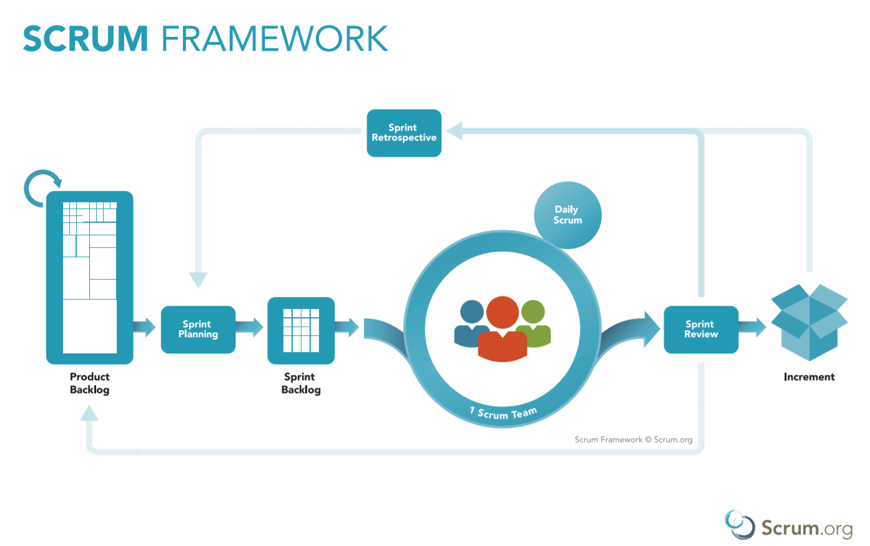
Delivery Approach
The delivery approach will be based on the Scrum Framework.
This will allow for the early delivery of outcomes as well as provide flexibility to adjust for any unforeseen opportunities or issues that are uncovered during the project.
A Backlog will be maintained to track outcomes to be delivered and indicate priority of these outcomes relative to each other. It is a living artifact that can change as we collaborate towards maximizing the value delivered.
The delivery team will meet with EIMS representatives every 2 weeks to demonstrate the outcomes delivered in the past 2-week period as well as plan which outcomes will be worked on in the next 2-week period. During this time, feedback will be incorporated into the backlog and cost/schedule forecasts will be updated and communicated.

